Slide 1
“Information Disorder: Understanding propaganda techniques during a war infodemic”

Slide 2
What is Propaganda

Slide 3
Definitions of Propaganda
Propaganda is a form of information that panders to our insecurities and anxieties. – Jacques Ellul, Propaganda: The Formation of Men’s Attitudes, 1962
Propaganda is the deliberate, systematic attempt to shape perceptions, manipulate cognitions, and direct behavior to achieve a response that furthers the desired intent of the propagandist. – Garth Jowett and Victoria O'Donnell, Propaganda and Persuasion, 1986
Propaganda is intentionally-designed communication that invites us to respond emotionally, immediately, and in a either-or manner. – Neil Postman, Technopoly, 1994
Propaganda is a form of purposeful persuasion that attempts to influence the emotions, attitudes, opinions, and actions of specified target audiences for ideological, political or commercial purposes through the controlled transmission of one-sided messages (which may or may not be factual) via mass and direct media channels. – Richard Alan Nelson, A Chronology and Glossary of Propaganda in the United States, 1996
Propaganda is the more or less systematic effort to manipulate other people’s beliefs, attitudes, or actions by means of symbols (words, gestures, banners, monuments, music, clothing, insignia, hairstyles, designs on coins and postage stamps, and so forth). Deliberateness and a relatively heavy emphasis on manipulation distinguish propaganda from casual conversation or the free and easy exchange of ideas. – Bruce Lannes Smith, Britannica, 1999
Propaganda is indifferent to truth and truthfulness, knowledge and understanding; it is a form of strategic communication that uses any means to accomplish its ends. – Walter Cunningham, The Idea of Propaganda, 2002

Slide 4
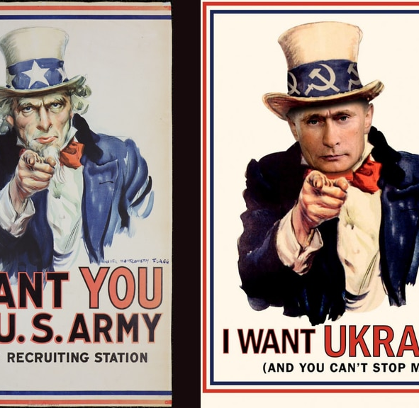
Characteristics of Propaganda

Slide 5
The term ‘propaganda’ is generally used when someone is aiming to reach a large group of people, not just a few.
People who create propaganda have a specific goal and design a communication message that is intended to circulate among a large group of people and create a reaction.
Propaganda involves reinforcing existing beliefs, changing perceptions, activating an emotional response or provoking a behavior.
The propagandist does not encourage independent judgement by presenting a variety of viewpoints and allowing the audience to determine which perspective is correct. Instead, the propagandist uses facts and information selectively, transmitting only those ideas that help accomplish the goal.
Perceptions of its impact will vary depending upon people’s individual identities, life experiences, and values.
Propaganda can’t be successful without the active participation of audiences.
(Source: Media Education Lab, 2015)

Slide 6
RUSSIA & UKRAINE
Both Ukraine and Russia are engaging in information operations and propaganda, but with different approaches.
The Kremlin focuses on deception operations, censorship and false narratives – especially that of “denazification”.
Ukraine is focused on diplomacy with the west and Nato, shoring up civilian morale and encouraging them to take up arms, highlighting Russian atrocities and Ukrainian combat wins and maintaining operational security (by denying Russia targeting information).
Ukraine has moral authority because it is using information operations to fight a war of necessity, – an existential battle of survival.
The Kremlin meanwhile, is trying to fulfil an ambition to rebuild the Soviet empire that had been shattered after the cold war.
(Source: theconversation.com)

Slide 7
ACTIVITY
Where Can Propaganda Be Found?
Working individually or with a partner, participants read about the 6 locations where propaganda can be found. Then they brainstorm at least one contemporary example for each of the six locations and describe it briefly in the space below.
(Source: Media Education Lab, 2015)
Journalism and Public Relations: Public relations is the term used for communication professionals who seek to shape perceptions and influence public opinion on behalf of a business client. In the U.S., there are four public relations professionals for every working journalist. PR people feed journalists information based on the agenda and goals of their clients. They may aim to get information and positive opinions about a business into the news by carefully crafting events, video news releases, blogging, newsletters, policy documents, and social media posts. In general, people are not aware of how public relations efforts have shaped the content of newspaper articles, blog posts, or other online information. | YOUR EXAMPLE:
Government and Politics: Throughout the 20th century, the United States has generated war propaganda by defining battles as conflicts between good and evil. Politicians use propaganda to get elected. They talk to reporters about topics and issues that get printed or broadcast as news. Propaganda can also used to help improve public health or address social issues. You may be familiar with public service announcements (PSAs) that aim to alter your behavior. By reshaping perceptions of social norms, public service campaigns can have a beneficial impact on changing attitudes and behaviors. | YOUR EXAMPLE:
Activism and Advocacy: People who are trying to improve society or create social change use propaganda to influence public opinion. Activists try to promote social, political, economic, or environmental change through using communication activities and public events that attract attention and influence people's knowledge, attitudes, and opinions. | YOUR EXAMPLE:
Advertising: There is a difference between advertising and propaganda. Advertising supports sales and marketing goals. Advertisers want to generate increased consumption of their commercial products and services by using a variety of forms of mass media and digital media to persuade readers, viewers, users or listeners. The public is generally aware of advertising and recognizes its purpose. Many forms of mass media that can be accessed for free—including broadcast television, radio, and search engines—depend on selling advertising space to businesses that want to sell products and services to audiences. But advertising can be propaganda when it activates strong emotions, attacks opponents, or simplifies information to shape people’s attitudes and behaviors. | YOUR EXAMPLE:
Education: From kindergarten to college, some forms of education are explicitly designed to lead people to accept a particular world view. Education can be a form of indoctrination when certain doctrines, ideas, information, values and beliefs are not permitted to be questioned. Propaganda enters the classroom in many ways. Many businesses and technology companies provide curriculum materials to educators. These are explicitly designed to promote a particular point of view. For example, Monsanto and other biotechnology firms provide videos, lesson plans, and other materials for science teachers. In Illinois, a state law mandates that schools promote a positive image for coal mining. | YOUR EXAMPLE:
Entertainment: Some stories are just entertainment, but many stories are also a form of propaganda. Stories offer ideas and information about good and evil, right and wrong, thus embedding values and ideology into narrative form. In many American movies and video games, violence is depicted as justified and morally courageous, which is a value message that is generally not questioned in society. Another way that propaganda is embedded in entertainment is through native advertising or sponsored content, where a company’s world view is presented as a form of entertainment. | YOUR EXAMPLE:

Slide 8
Information Disorder | Fake News

Slide 9
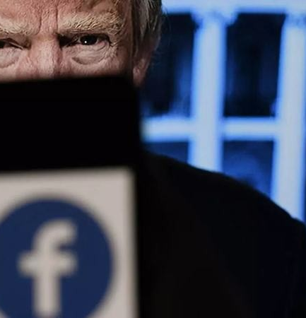
Fake News & Trust Chains
a made-up, untrue story or invented “fact” that has been written or presented to seem genuine
or
an accusation that a genuine news story or actual fact is false, in order to undermine it.

Slide 10
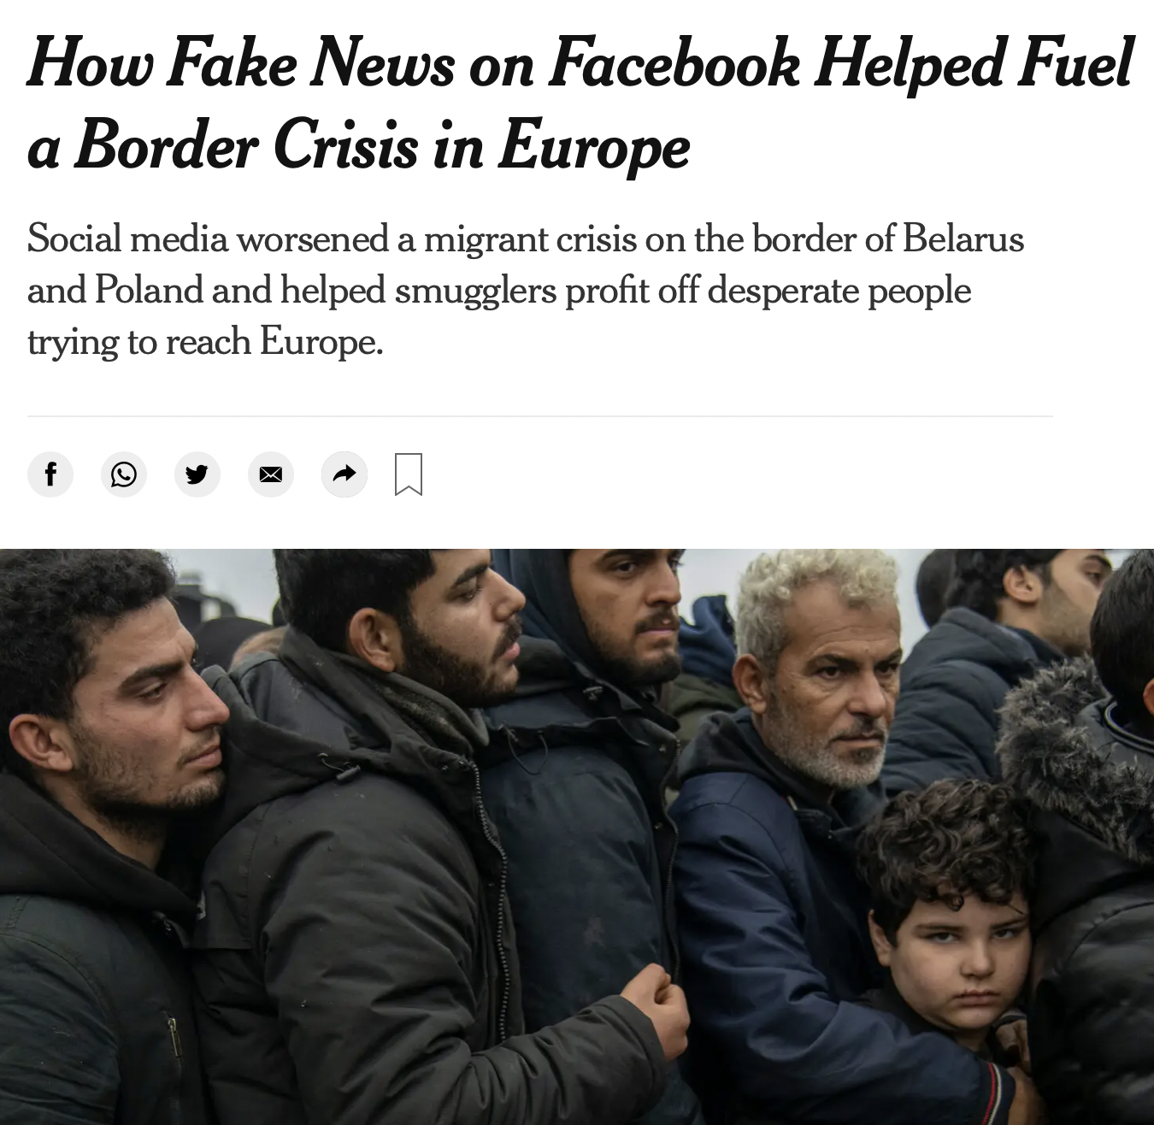
Different kinds of fake news
Genuine errors
News that is wrong because of mistakes, carelessness, genuine misunderstanding or because the person generating the news or passing it on is not really good at it. This type of “fake news” has always existed and we generally forgive those responsible as “only human”.
Satire News presented as satire – or satire presented as news. This is made-up news printed or broadcast in such a way that it is obvious to readers and viewers that it is not true, just a joke
Half-truths Thirdly there is the kind of disinformation that takes real, provable facts and twists them, usually by selectively quoting some parts but not others.
Manufactured news The most harmful kind of “fake news” is made up or manufactured in order to deceive. Repeated often and long enough, this maliciously manufactured “fake news” not only damages the kind of rational discussion necessary for the functioning of democracy, but it leaves readers, listeners and viewers wondering just what they can believe, if anything at all.
Image credit: New York Times

Slide 11
Facts & Figures
Two thirds of EU citizens report coming across fake news at least once a week. (European Commission, 2018b)
Over 80% of EU citizens say they see fake news both as an issue for their country and for democracy in general. (European Commission, 2018b)
Half of EU citizens aged 15-30 say they need critical thinking and information skills to help them combat fake news and extremism in society. (European Commission, 2018a)

Slide 12
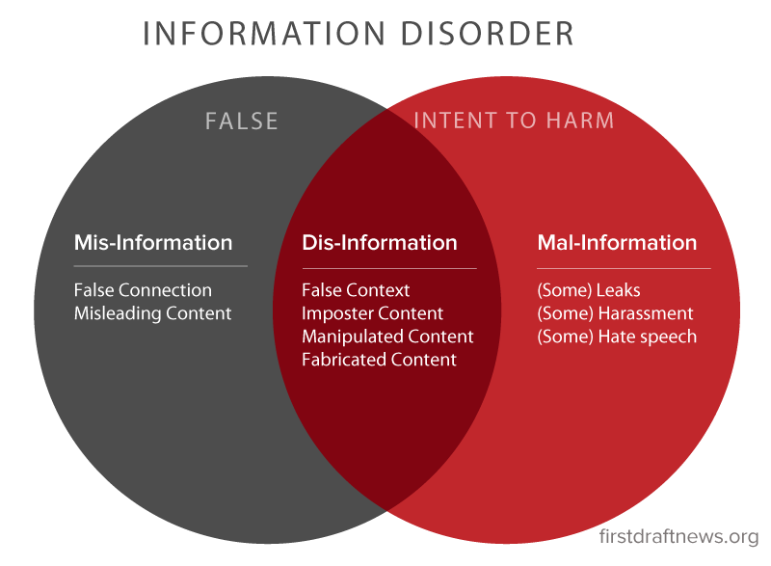
INFORMATION DISORDER
Wardle and Derakhshan (2017) introduce a new conceptual framework for examining information disorder, identifying the three different types:

Slide 13
ACTIVITY
Give participants the following questions or others that would be built on this part of the module. Ask them to answer according to what they have been taught in this part of the module.
Reflect on their answers.
Questions - match the term with its definition:
Information based on reality, used to inflict harm on a person, organization or country and being used strategically to cause harm
Choose one:
Mis-information
Dis-information
Mal-information .
Information whose inaccuracy is unintentional.
Choose one:
Mis-information .
Dis-information
Mal-information
Information that is deliberately false or misleading, and which is intentionally created to harm.
Choose one:
Mis-information
Dis-information .
Mal-information

Slide 14
What is an Infodemic?
In conflict situations and wars, the roThe term ‘Infodemic’ (Information + Epidemic) was first used in 2003 by David Rothkopf in connection with SARS. It has seen renewed usage during the COVID-19 pandemic. The term can appear in other occasions too, such as conflict situations and wars.
le of the media is critical in providing the public with accurate and timely information. Trustworthy news and images can contribute to the protection of civilians and conflict prevention, bring to the attention of the international community the horrors and reality of conflict and expose violations of human rights and international humanitarian law. (Source: Council of Europe).
Definitions of Infodemic
Infodemic is a situation where "a few facts, mixed with fear, speculation and rumor, amplified and relayed swiftly worldwidae by modern information technologies" (David Rothkopf, 2003)
According to the Cambridge Dictionary, an Infodemic is “a situation in which a lot of false information is being spread in a way that is harmful”.
According to Wikipedia, an Infodemic is “a rapid and far-reaching spread of both accurate and inaccurate information about something, such as a disease”.
According to WHO, “An infodemic is too much information including false or misleading information in digital and physical environments during a disease outbreak. It causes confusion and risk-taking behaviours that can harm health. It also leads to mistrust in health authorities and undermines the public health response. An infodemic can intensify or lengthen outbreaks when people are unsure about what they need to do to protect their health and the health of people around them. With growing digitization – an expansion of social media and internet use – information can spread more rapidly. This can help to more quickly fill information voids but can also amplify harmful messages.”

Slide 15
Definitions of Infodemic
Infodemic is a situation where "a few facts, mixed with fear, speculation and rumor, amplified and relayed swiftly worldwidae by modern information technologies" (David Rothkopf, 2003)
According to the Cambridge Dictionary, an Infodemic is “a situation in which a lot of false information is being spread in a way that is harmful”.
According to Wikipedia, an Infodemic is “a rapid and far-reaching spread of both accurate and inaccurate information about something, such as a disease”.
According to WHO, “An infodemic is too much information including false or misleading information in digital and physical environments during a disease outbreak. It causes confusion and risk-taking behaviours that can harm health. It also leads to mistrust in health authorities and undermines the public health response. An infodemic can intensify or lengthen outbreaks when people are unsure about what they need to do to protect their health and the health of people around them. With growing digitization – an expansion of social media and internet use – information can spread more rapidly. This can help to more quickly fill information voids but can also amplify harmful messages.”

Slide 16
ACTIVITY
The first word that comes to your mind when you hear:
Propaganda
Fake News
Information Disorder
Infodemic
Create four ‘world clouds’ with participants’ answers.

